Slide 1


8th Collaborative Online International Learning
PosePerfect: AI-Powered Gym Workout Tracker
Tristan Jadman
Ian James Cruza

Slide 2
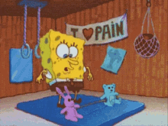
Introduction
Tracking workouts helps improve performance and stay safe, but most workout logs are manual and don’t give real-time updates.
Problem: Manual tracking leads to distracting, inconsistent data, while a lack of feedback causes overtraining, poor motivation, and unclear progress.
8th Collaborative Online International Learning
Notes:
We all know that tracking workouts is essential for making progress. But the problem is that the way we track is often broken.
This leads directly to the core problem we are addressing: Manual tracking is distracting and gives us inconsistent data. This lack of good feedback leads to overtraining, poor motivation, and unclear progress.

Slide 3
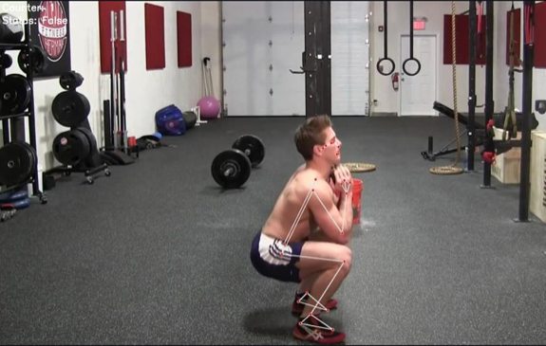
Introduction
Existing Solutions
AI Human Fitness Tracker using Computer Vision with MediaPipe
8th Collaborative Online International Learning
Notes:
AI Human Fitness Tracker using Computer Vision with MediaPipe
Function: Their system uses pose detection to find your joints and then follows hard-coded rules (like tracking an elbow angle) to count reps for a single, pre-selected exercise.
Problem: It only functions as a rep counter and cannot automatically identify which exercise you are performing from a list of many.
Link:
https://doi.org/10.22214/ijraset.2025.70547

Slide 4
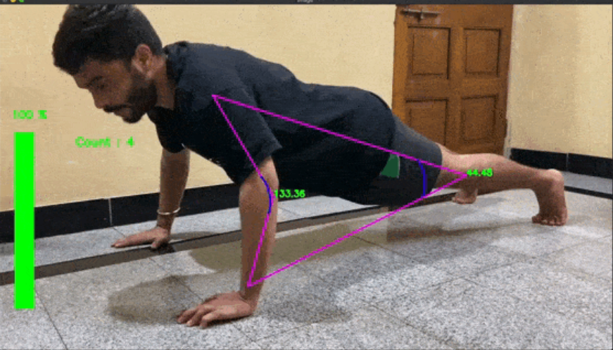
Introduction
Existing Solutions
AI Human Fitness Tracker using Computer Vision with MediaPipe
GymLytics: AI-powered Real-Time Workout Analytics
8th Collaborative Online International Learning
Notes:
GymLytics: AI-powered Realtime Workout Analytics - This open-source project uses MediaPipe for pose estimation to track body movements, correct posture, and count reps
Function: It's a rep counter for 5 exercises that must be manually selected by the user before they start.
Problem: It is not automatic, it is not scalable, and it has no features for logging data or viewing long-term progress.
Link:
https://github.com/akshaybahadur21/GymLytics

Slide 5
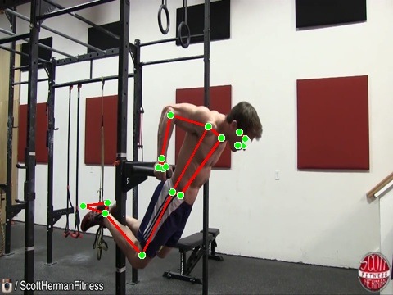
Introduction
Existing Solutions
AI Human Fitness Tracker using Computer Vision with MediaPipe
GymLytics: AI-powered Real-Time Workout Analytics
A Machine Learning Approach to Accurate Gym Exercise Form Detection Using MediaPipe
8th Collaborative Online International Learning
Notes:
A Machine Learning Approach to Accurate Gym Exercise Form Detection Using MediaPipe - To detect and evaluate gym exercise form using pose estimation from MediaPipe. The system computes joint angles to assess whether a user performs exercises such as squats or bicep curls correctly.
Link:
https://www.ijraset.com/research-paper/accurate-gym-exercise-form-detection-using-mediapipe

Slide 6
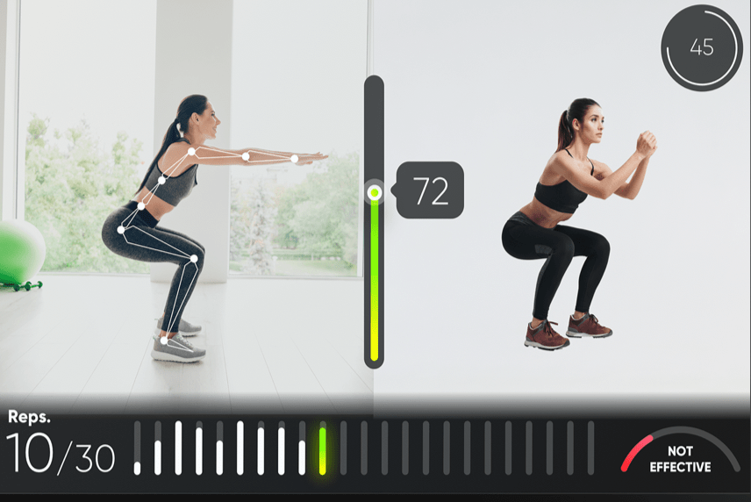
Introduction
Differentiator
Real-Time Tracking System
8th Collaborative Online International Learning
Notes:
So, what makes our study unique? It combines three key features into one system.
Real-time tracking - It uses motion analysis to accurately count repetitions and automatically record each set.

Slide 7

Introduction
Differentiator
Real-Time Tracking System
AI-Powered Insight System
8th Collaborative Online International Learning
Notes:
AI-powered insight system. It serves as a smart coach with two modes, a rule-based for instant feedback and AI-generated for adaptive guidance. Also offering voice coaching and fatigue detection.

Slide 8
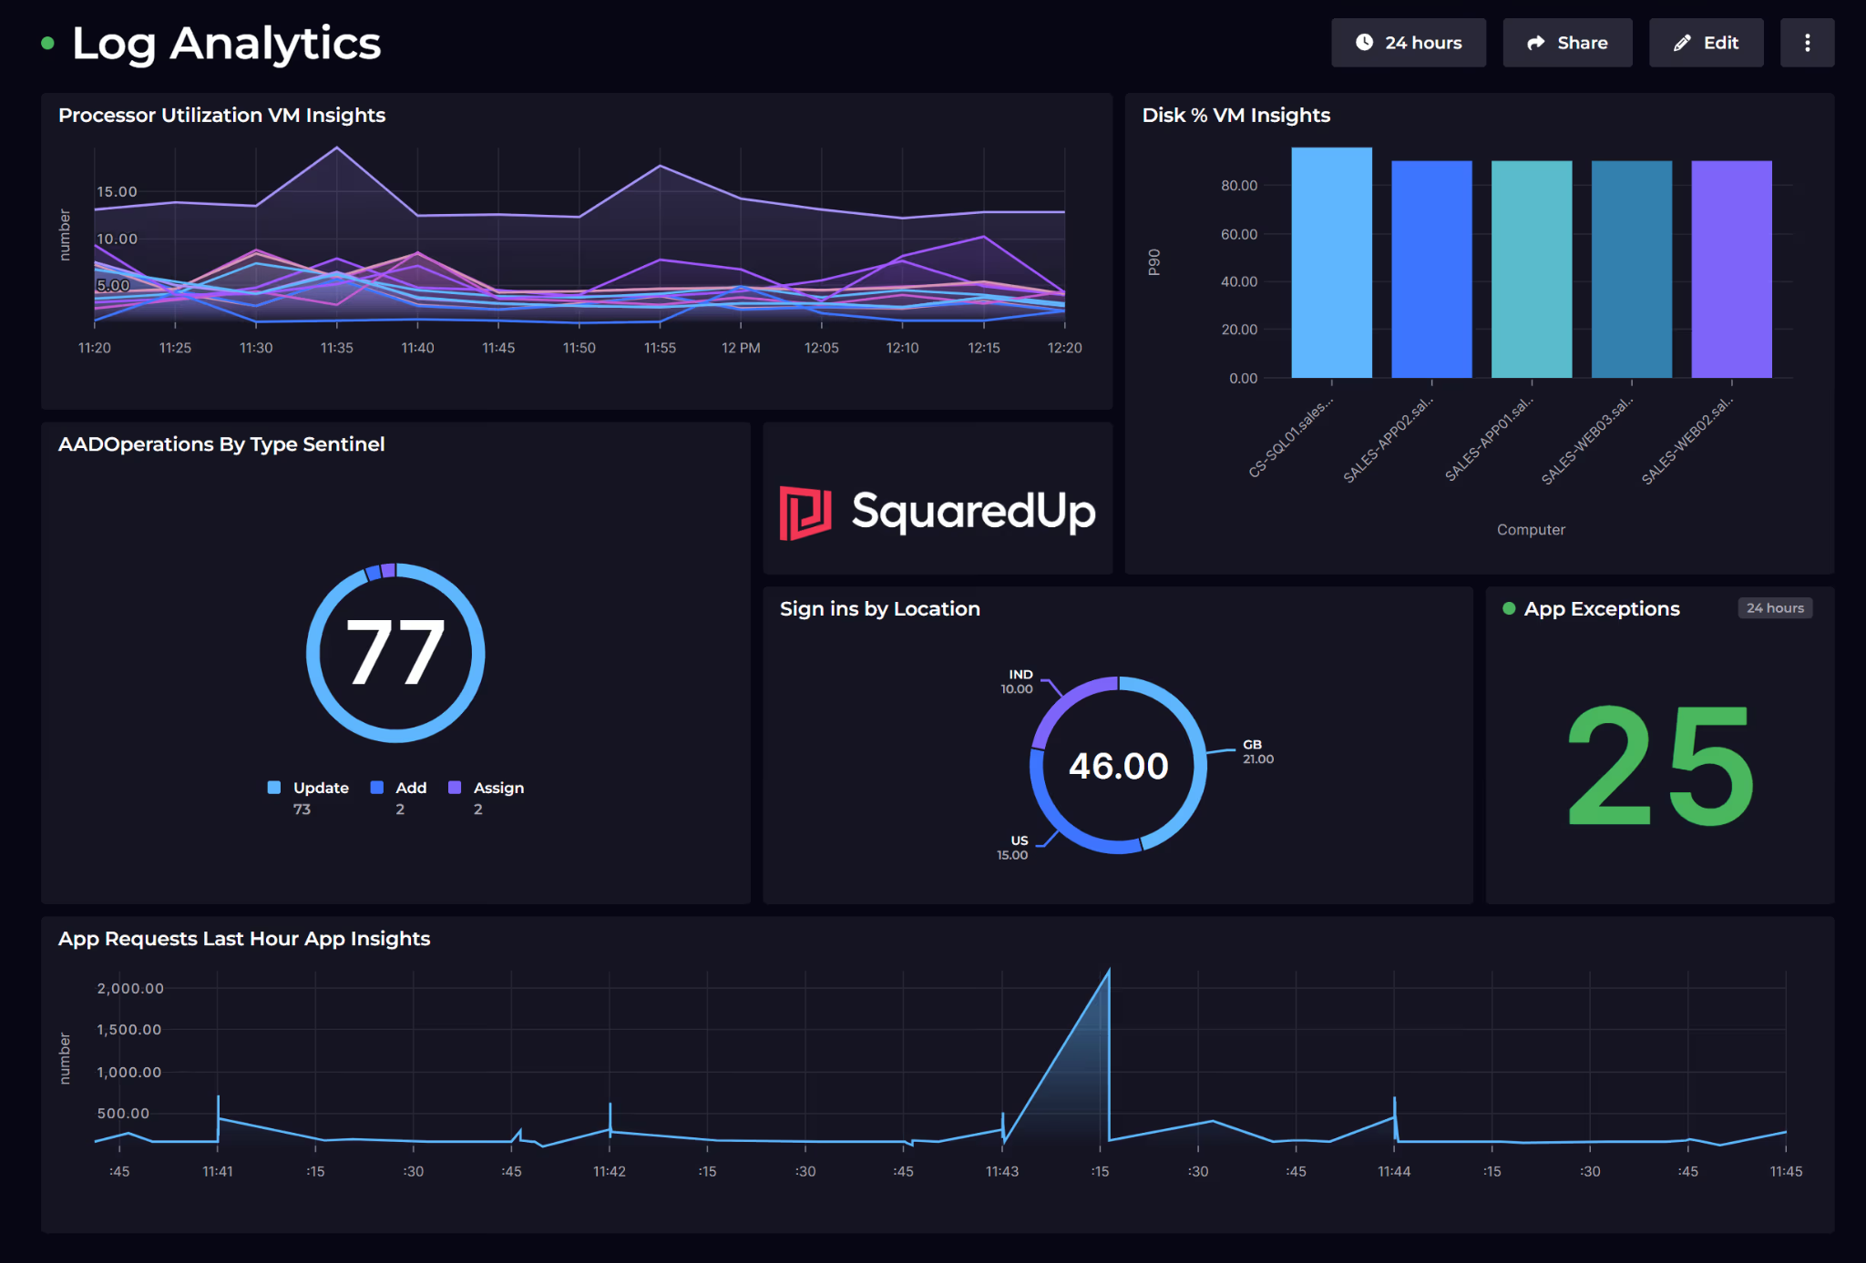
Introduction
Differentiator
Real-Time Tracking System
AI-Powered Insight System
Advanced Analytics Dashboard
8th Collaborative Online International Learning
Notes:
Advanced analytics dashboard - It features a GitHub-style heatmap for consistency, muscle balance charts, and linear regression to predict future performance.

Slide 9

Introduction
Differentiator
Real-Time Tracking System
AI-Powered Insight System
Advanced Analytics Dashboard
High-Accuracy Model: SigLIP 2 Model with (96.38%)
8th Collaborative Online International Learning
Notes:
High-Accuracy Model: Built on a fine-tuned SigLIP 2 model with 96.38% accuracy across 22 common exercises.

Slide 10
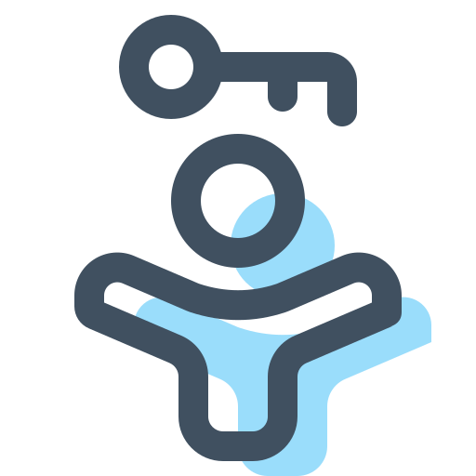
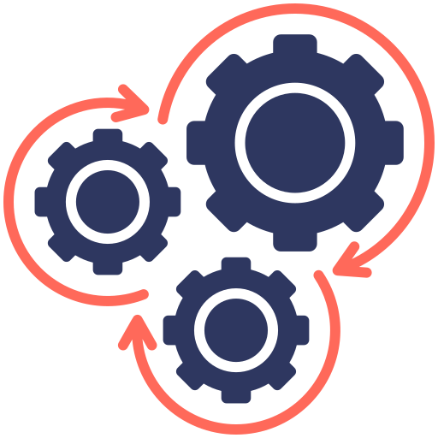

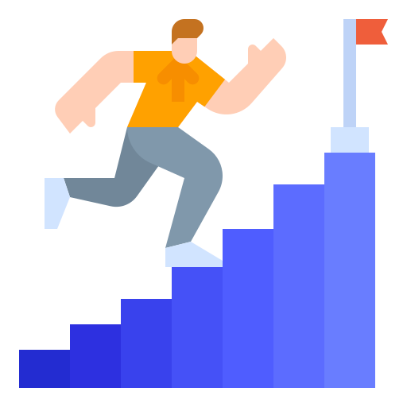
Introduction
Benefit of the Study
Accessibility
Performance Optimization
Actionable Insights
Motivation
8th Collaborative Online International Learning
Notes:
Accessibility: Transforms any standard webcam and computer into a sophisticated personal trainer, making advanced analytics free and accessible.
Performance Optimization: Provides users with data to make smarter training decisions, such as tracking volume trends and personal records.
Actionable Insights: "Train smarter, not harder." The dashboard helps users understand their muscle balance, manage fatigue, and prevent overtraining.
Motivation: Gamification through streaks, personal records, and unlockable achievement badges makes fitness more engaging and helps build consistency.

Slide 11

Methodology
PHASE 1: Real Time Loop
Video Capture
8th Collaborative Online International Learning
Notes:
Video Capture: Grabs one frame from the webcam.

Slide 12
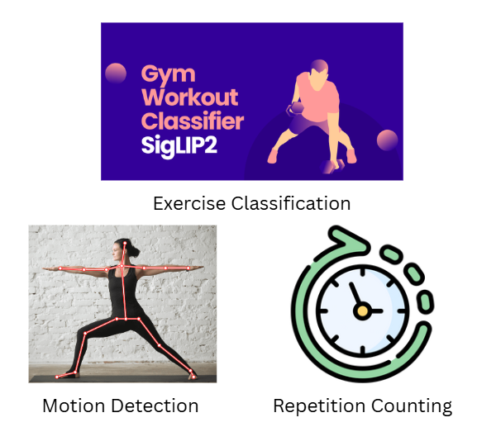
Methodology
PHASE 1: The Real Time Loop
Video Capture
Main Thread Processes
8th Collaborative Online International Learning
Notes:
Main Thread Processes: This single frame is analyzed to:
Perform Exercise Classification (using the Gym-Workout-Classifier-SigLIP2 model).
Run Motion Detection and Rep Counting (using the motion intensity algorithm).

Slide 13

Methodology
PHASE 1: The Real Time Loop
Video Capture
Real-Time UI Rendering
Main Thread Processes
8th Collaborative Online International Learning
Notes:
UI Rendering: Displays the video frame with overlay statistics (like "Push-ups: 7") on the screen.

Slide 14
Methodology
PHASE 1: The Real Time Loop
Video Capture
Real-Time UI Rendering
Main Thread Processes
8th Collaborative Online International Learning
Notes:
Loop: The process immediately loops back to Step 1 to grab the next frame. This repeats many times per second to create a smooth, live video.

Slide 15
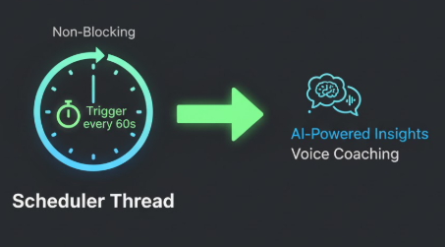
Methodology
PHASE 2: The Parallel Coaching Loop
Scheduler Thread
8th Collaborative Online International Learning
Notes:
This runs at the same time as the Real-Time Loop, on its own schedule.
Scheduler Thread: A non-blocking timer waits for 60 seconds to pass.

Slide 16
Methodology
PHASE 2: The Parallel Coaching Loop
Scheduler Thread
Insight Worker Thread
8th Collaborative Online International Learning
Notes:
Insight Worker Thread: Once triggered, this thread:
Generates the AI-Powered Insight (either Rule-Based or with the Flan-T5 model).
Activates Voice Coaching by sending the text to the Text-to-Speech (TTS) engine.
Loop: The Scheduler Thread resets and waits for the next 60 seconds.

Slide 17
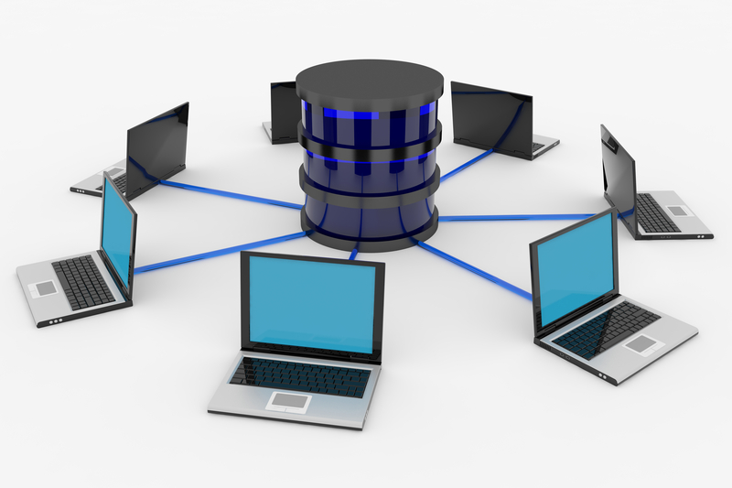
Methodology
PHASE 3: Post Workout Analytics
Data Persistence
8th Collaborative Online International Learning
Notes:
The Final Analytics (Post-Workout)
This is a one-time, sequential process that happens only after the user stops the Real-Time Loop (e.g., by pressing 'q').
Data Persistence: All the exercise and rep data from the session is saved to the workout_history.json file.

Slide 18
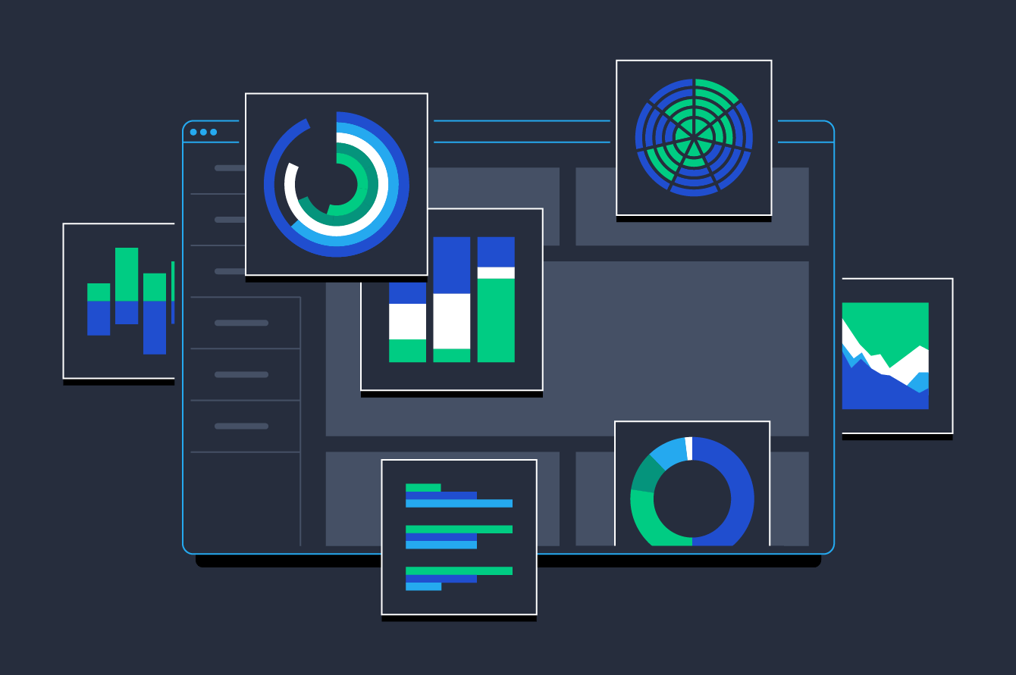
Methodology
PHASE 3: Post Workout Analytics
Data Persistence
Dashboard Visualization
8th Collaborative Online International Learning
Notes:
Dashboard Visualization: This is a separate, manual step. The user opens the dashboard.html file in a browser, which reads the JSON file and displays all the advanced analytics (heatmaps, fatigue detection, PRs, etc.).

Slide 19
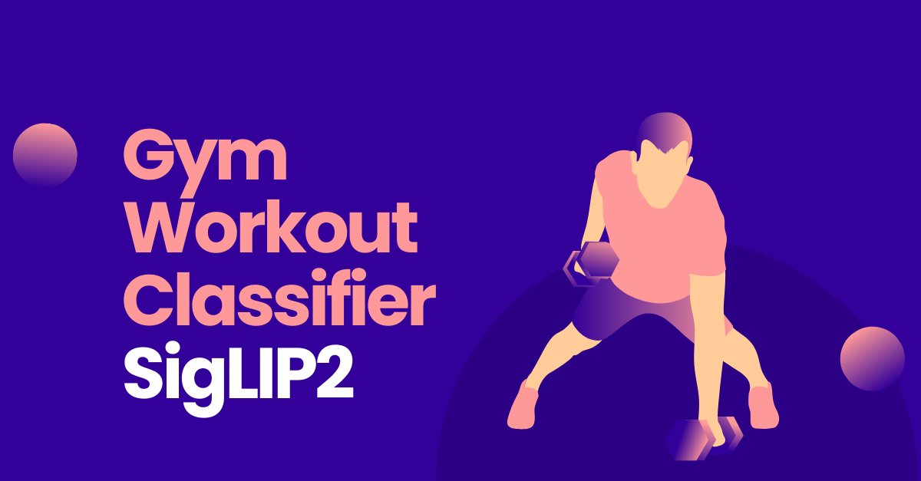
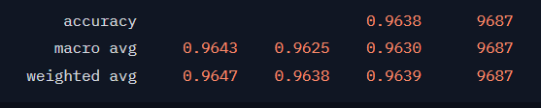
Results
Model: Gym-Workout-Classifier-SigLIP2
8th Collaborative Online International Learning
Notes:
Here we have the quantitative results for our core classification model, the 'Gym-Workout-Classifier-SigLIP2'.
As you can see from the report, the key number is the overall accuracy, which is 96.38%. This confirms the model is highly effective at identifying the 22 different exercises.This high accuracy is also supported by the other metrics, like the Weighted Avg Precision at over 96.4% and the F1-Score at 96.39%, which shows our model is consistently reliable.

Slide 20
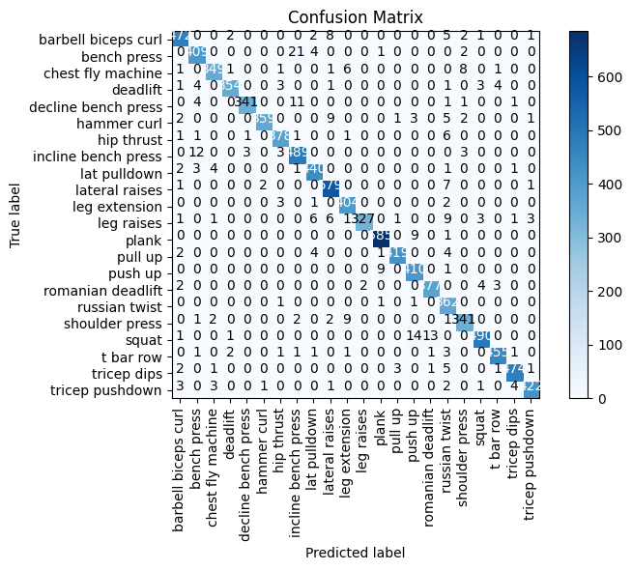
Results
Confusion Matrix:
8th Collaborative Online International Learning
Notes:
This is our Confusion Matrix, which is the visual proof of our model's accuracy.
The vertical axis shows the true exercise, and the horizontal axis shows what our AI predicted. The dark blue diagonal line shows all the correct answers, where the AI's prediction perfectly matched the truth. The few numbers off the diagonal are the rare mistakes, like confusing a 'shoulder press' with a 'squat'. This proves the model's high performance, achieving a 96.38% overall accuracy."

Slide 21
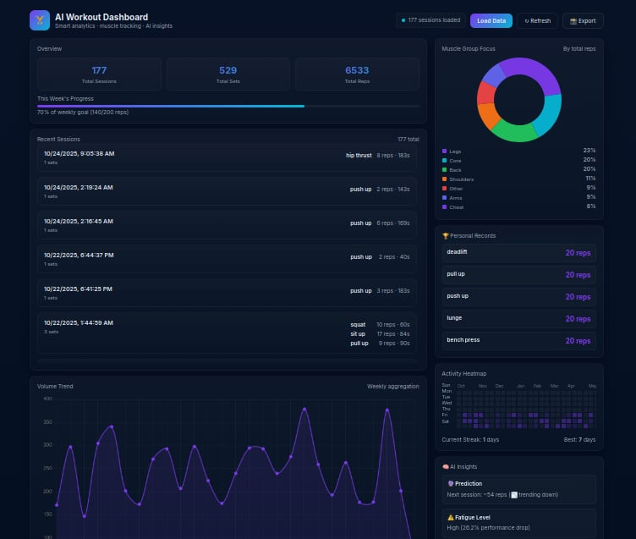
Results
An advanced analytics dashboard (dashboard.html) that visualizes all captured data.
Key components include:
Activity Heatmap
Performance Analytics
Smart Metrics
Gamification
8th Collaborative Online International Learning
Notes:
Activity Heatmap: A "GitHub-style" grid showing workout consistency and streaks.
Performance Analytics: Automatically tracks Personal Records (PRs), weekly volume trends, and muscle group balance.
Smart Metrics: Displays the 0-100 Recovery Score, current fatigue level, and AI-driven rest recommendations.
Gamification: A full system of unlockable badges for reaching milestones

Slide 22
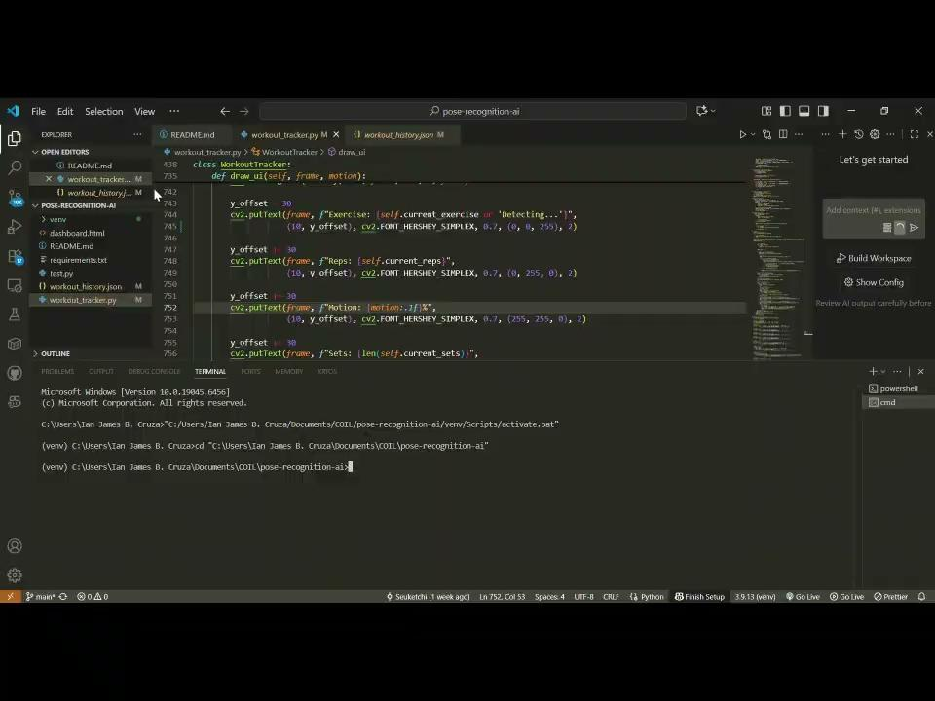
Demonstration
Demo 1
8th Collaborative Online International Learning
Notes:
DEMO 1

Slide 23
Thank You!
ありがとう
8th Collaborative Online International Learning
Notes:
Content 3

